Slide 1
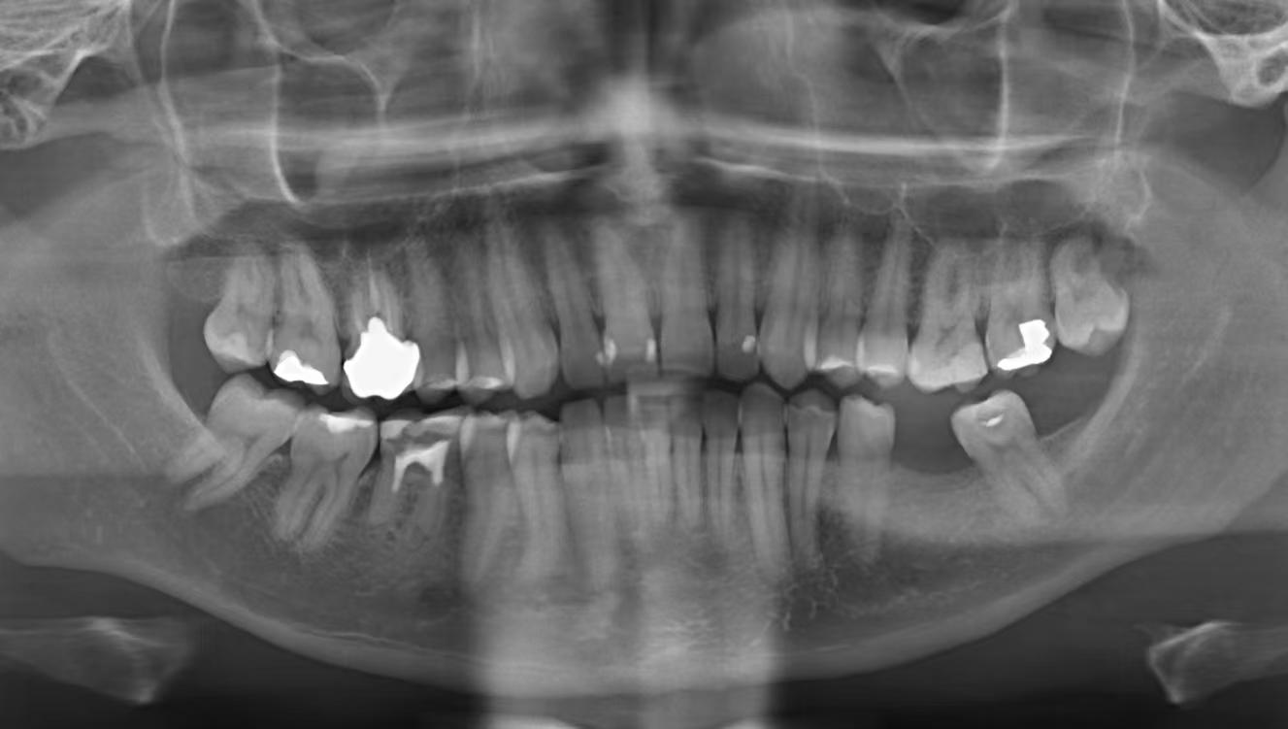
Information Bottleneck
Broken Information
Multi-level Auxiliary Information
pooling
unpooling
Prediction head
Auxiliary branch
Heavy Cost
Main branch
Auxiliary Reversible Branch
(a) PAN
(b) RevCol
(c) Deep Supervision
(d) Programmable Gradient Information

